Slide 1

ByteCook
Challenge No. 2

Slide 2
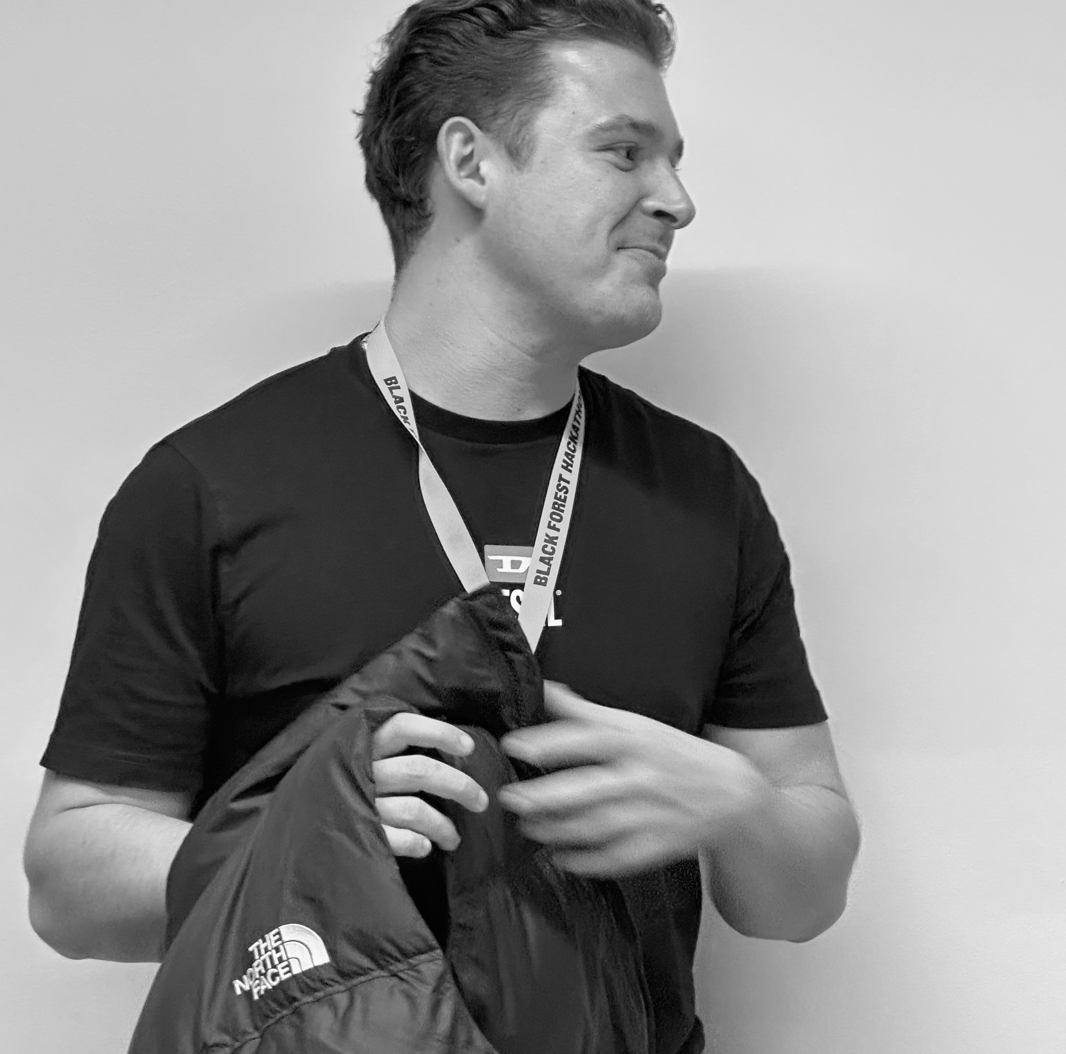




Team
Jannik
Sebastian
Robert
Philipp
Chris

Slide 3
Idea
Stock Keeping Unit
PDF
Data Augmentation
Text Extraction
LLM
Structuring & Mapping
App
Results

Slide 4
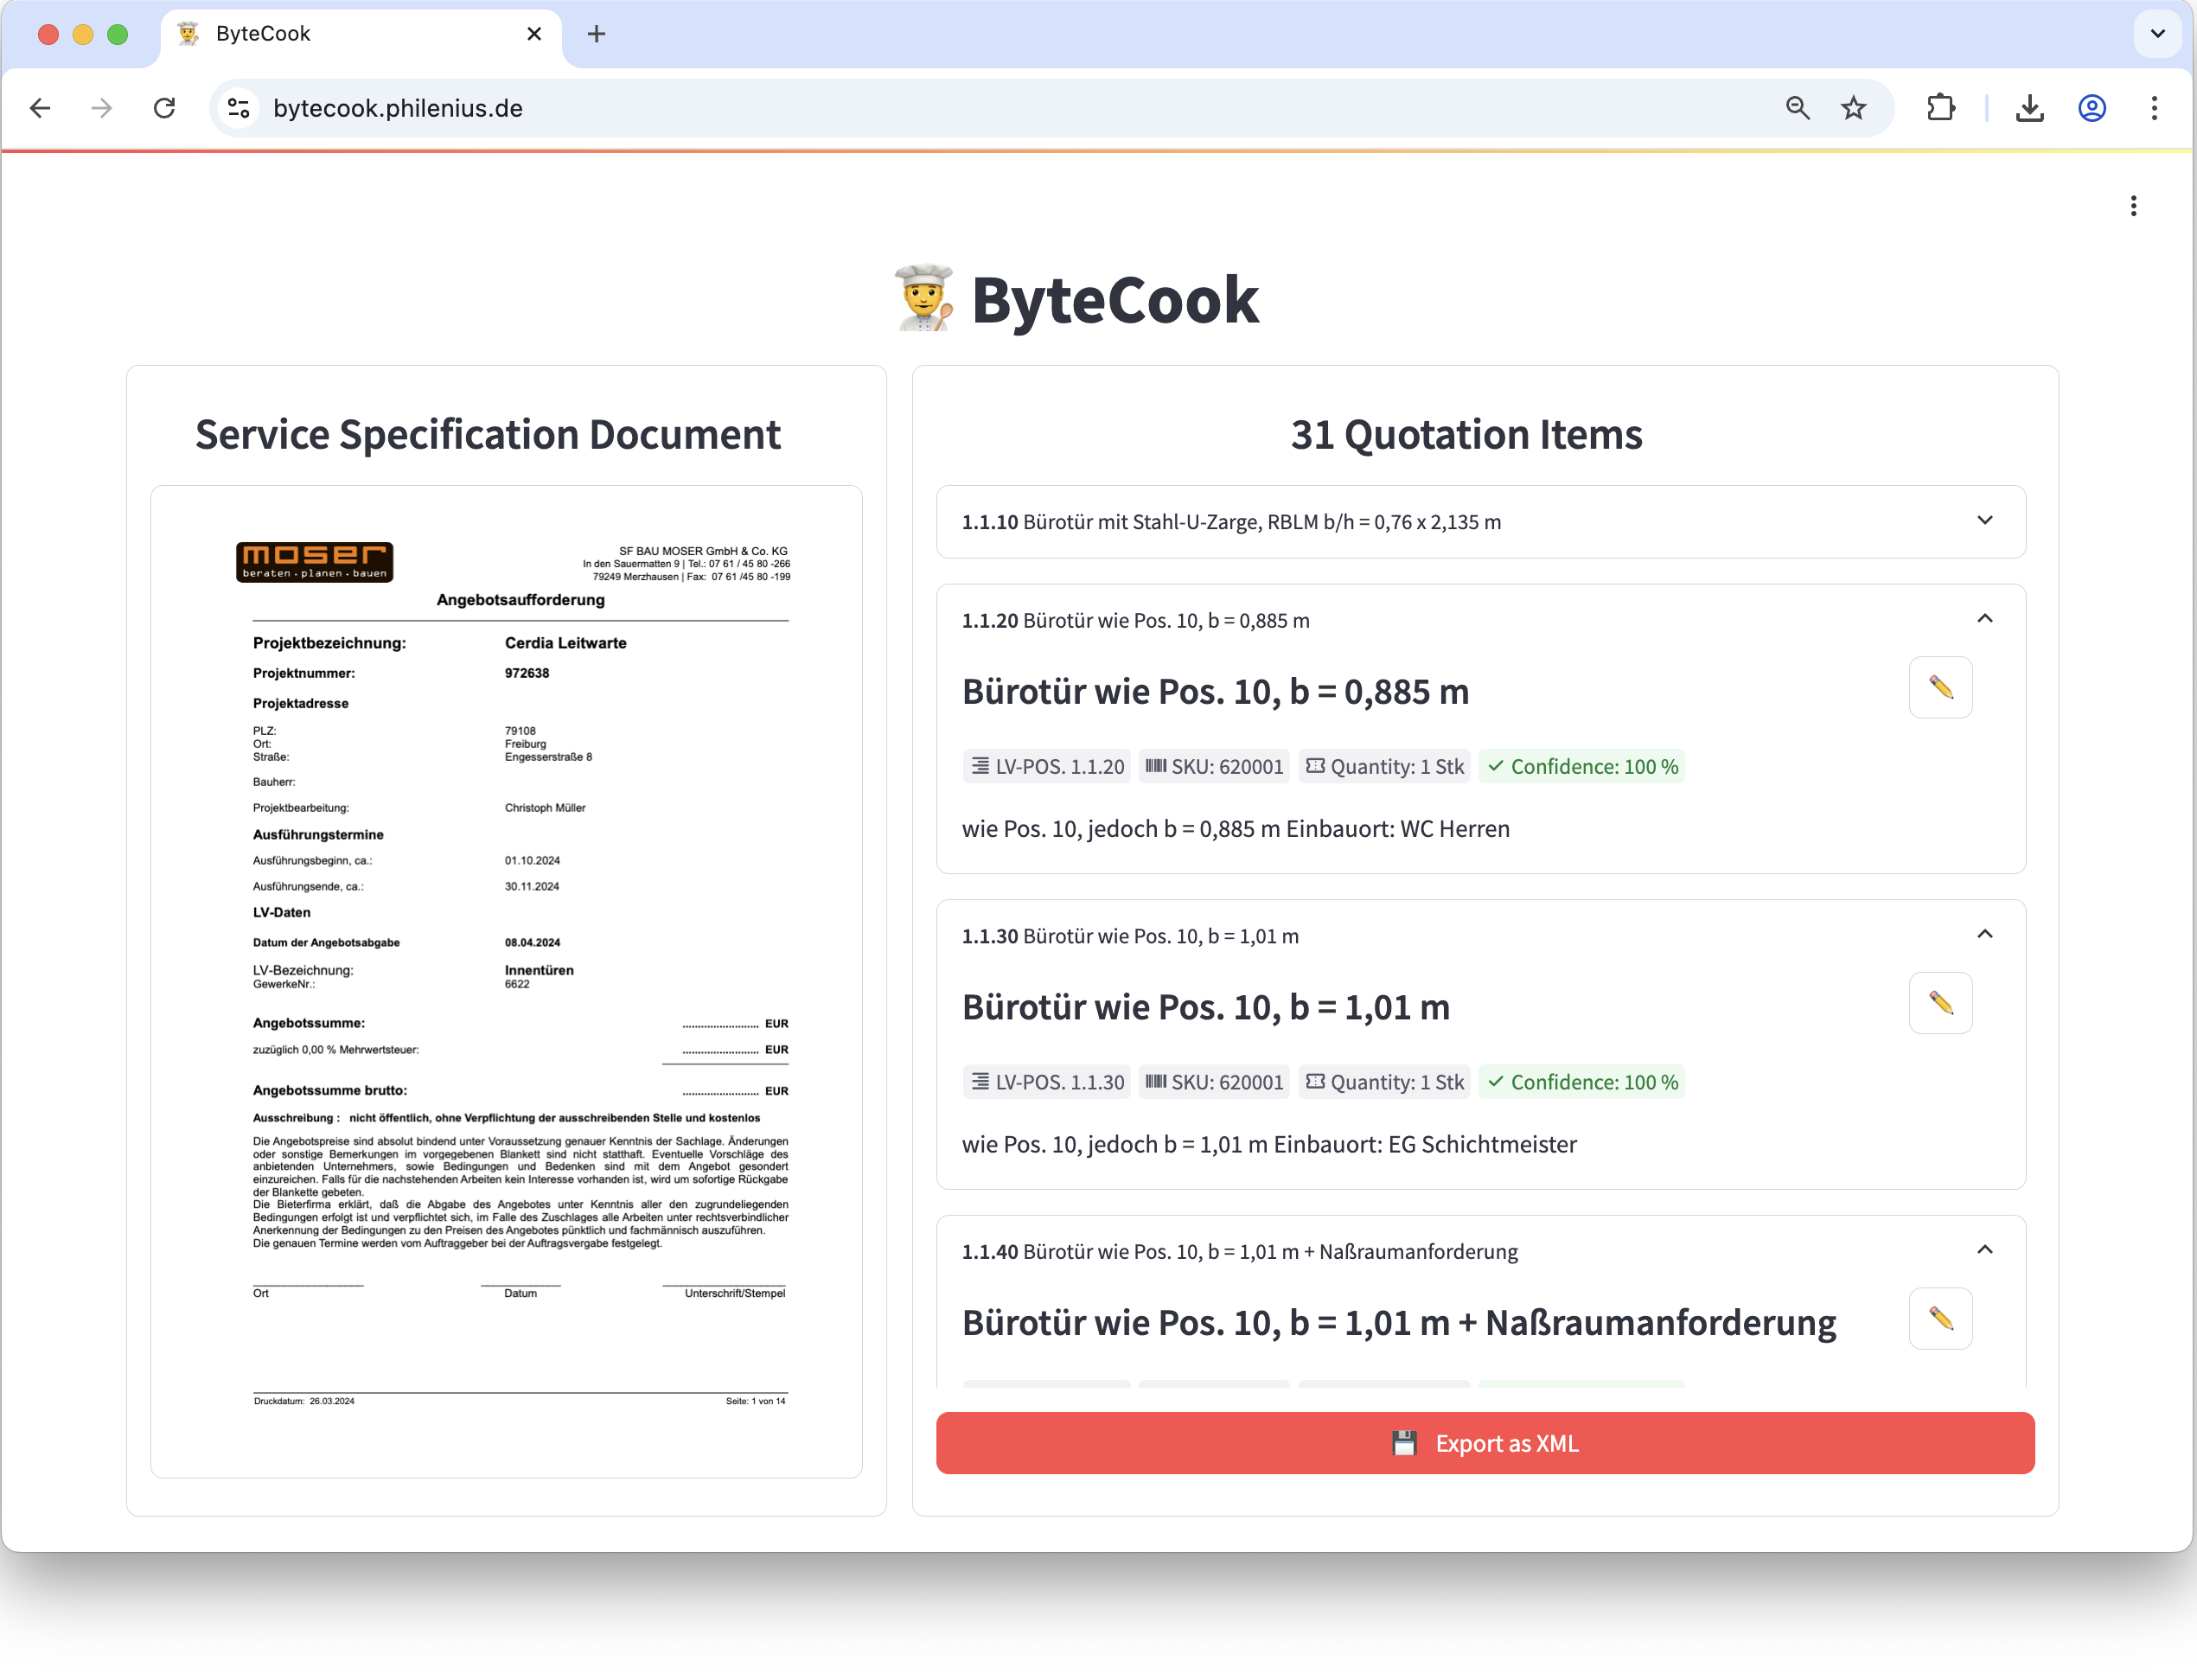
Solution
Show relevant Positions
Upload
PDF
Show Information

Slide 5
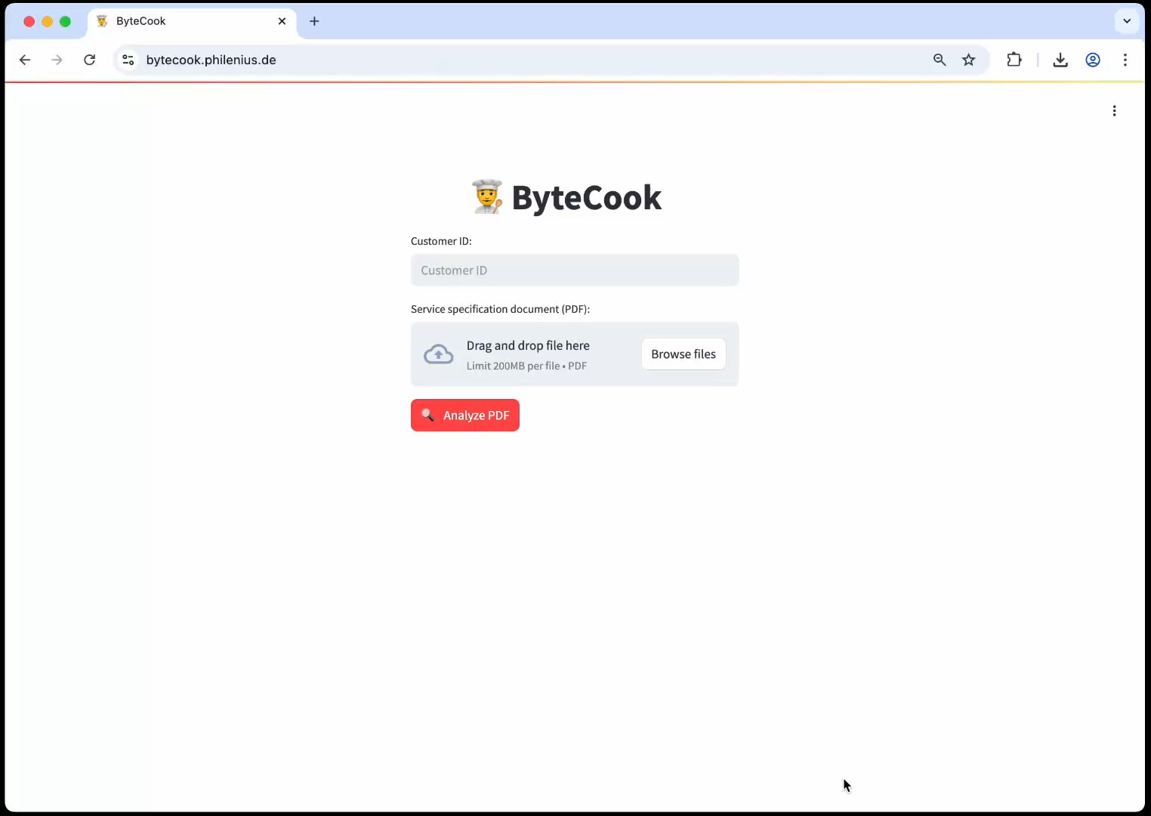
Demo

